Slide 1

PHRASAL VERBS unit 24
LE – 22
Alina Pankova

Slide 2
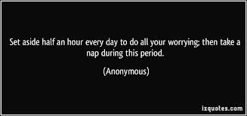
SET ASIDE
to reserve for a special purpose; put to one side
to discard, dismiss, or quash

Slide 3

SET IN
to become established
to blow or (of current) to move towards shore

Slide 4
SET DOWN
(British) to allow (passengers) to alight from a bus, taxi, etc
to snub; dismiss
to judge, consider, or regard
to write down or record

Slide 5

SET OFF
to embark on a journey
to cause to explode

Slide 6

SET OUT
to begin or embark on an undertaking, esp a journey
to give a full account of; explain exactly
to plan or lay out

Slide 7
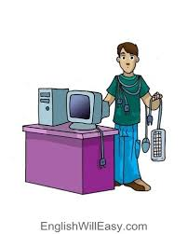
SET UP
to establish
to cause (a person) to be blamed, accused, etc
to build or construct

Slide 8

SETTLE DOWN
to adopt an orderly and routine way of life, take up a permanent post, etc, esp after marriage
to make or become quiet and orderly

Slide 9
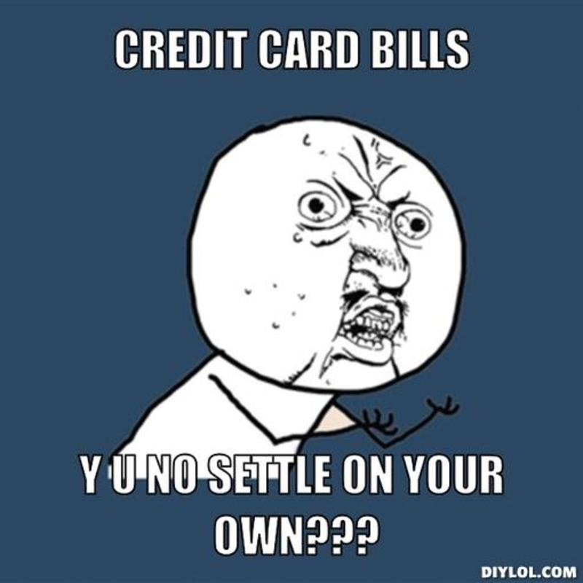
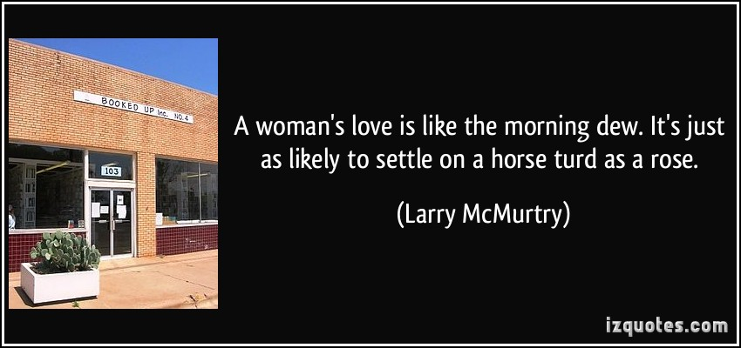
SETTLE ON
to make a decision or come to an agreement about something

Slide 10


SETTLE UP
to pay someone what one owes; to pay one one's share of something.

Slide 11
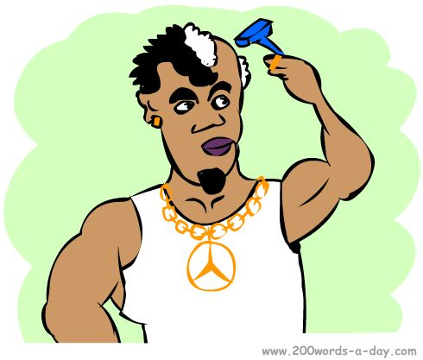
SHAVE OFF
to cut hair from part of your body using a razor or a shaver

Slide 12

SHOP AROUND
to go to several stores before you decide what particular thing to buy

