Slide 1

Phrasal verbs
Unit 25

Slide 2
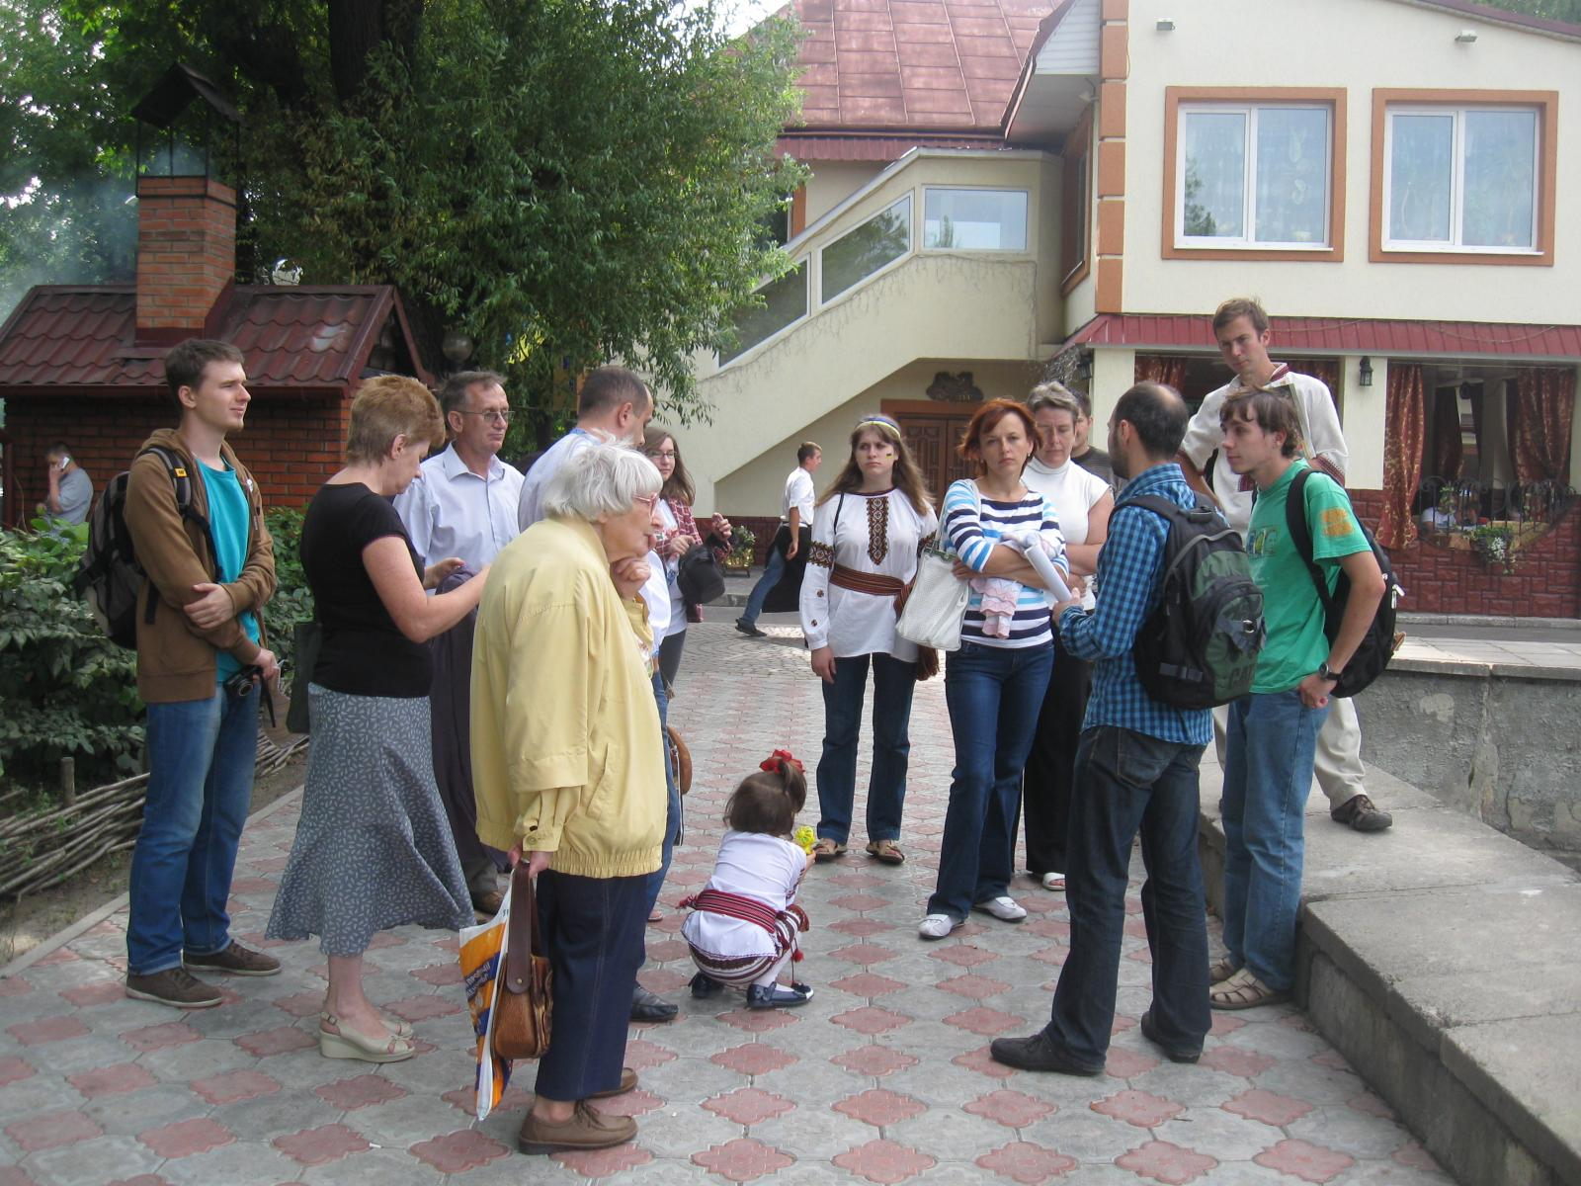
To show around
показати
провести по
The guide showed us around the city.

Slide 3
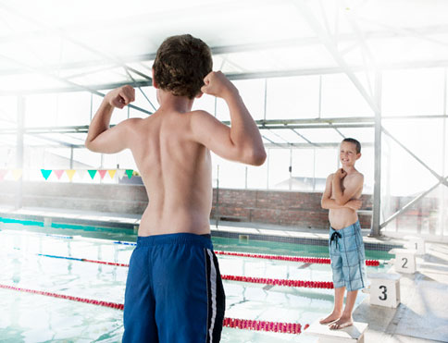
To show off
напускати туману
хизуватися
He likes to show off.

Slide 4
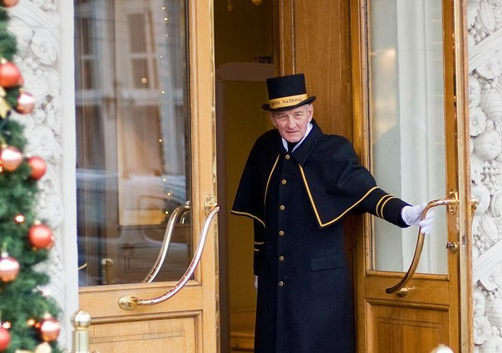
To show up
з’явитися
The boss was very upset when you didn’t show up for meeting.

Slide 5
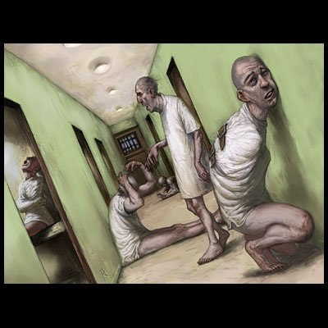
To shut away
ув’язнити ( у психіатричних лікарнях)
Many people have been shut away in psychiatric hospitals for disagreeing with the government.

Slide 6

To shut down
закривати
The shop shut down when the out-of-town supermarket opened.

Slide 7

To shut off
перекривати
They shut the water off while they did the repairs.

Slide 8

To shut up
стулити пельку
замовкнути
He told us to shut up and start working.

Slide 9

To sign for
підписувати за
My boss was out for the day, so I signed the letters for him.

Slide 10
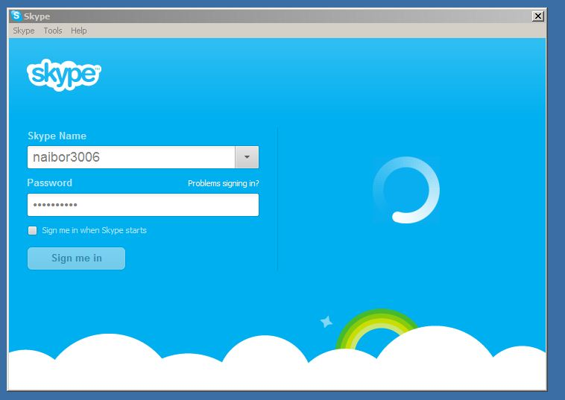
To sign in
реєструвати в комп’ютері
I signed in and started chatting online.

Slide 11
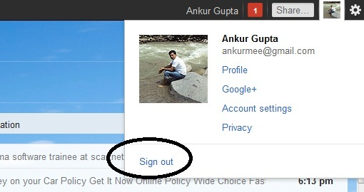
To sign out
виходити з програми
I signed out and then shut the computer down.

Slide 12

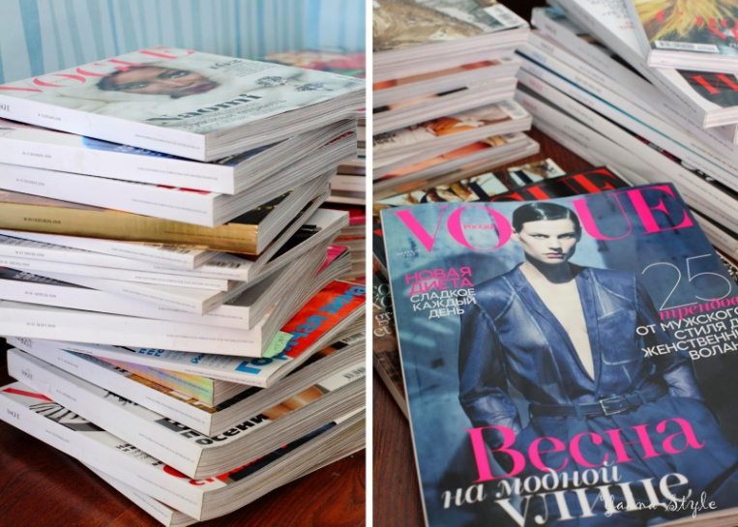

To sign up
реєструвати в комп’ютері для роботи в програмі.
I signed up for Hotmail.
записуватися
I’ve signed up as a volunteer.
передплачувати
I’ve signed up for the magazine.

Slide 13

To size up
оцінити
The door staff sized up everyone entering the club.

Slide 14

To slip out
вислизнути
The party was really dull, so we slipped out and went to the pub instead.

Slide 15
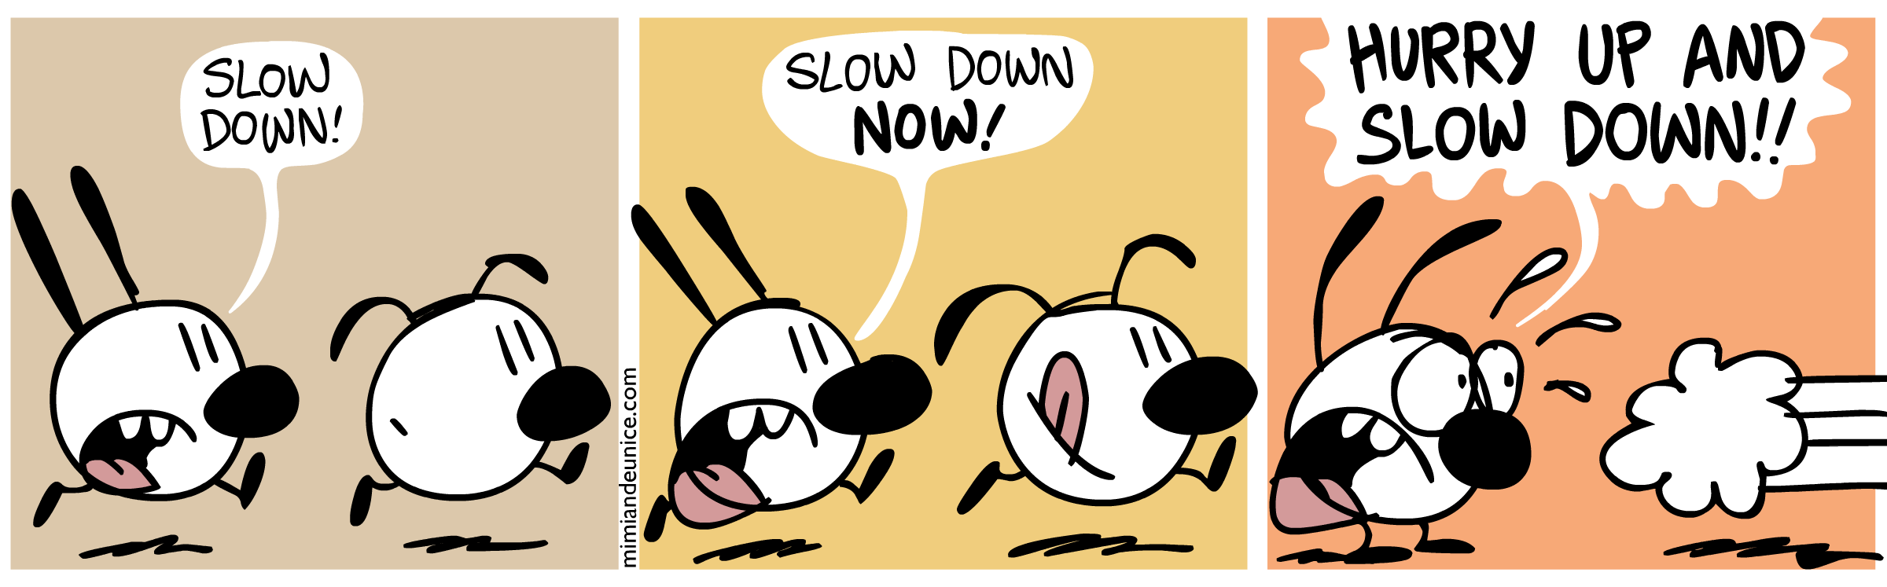
To slow down
Уповільнити хід, темп
The car slowed down when they saw the police.

Slide 16
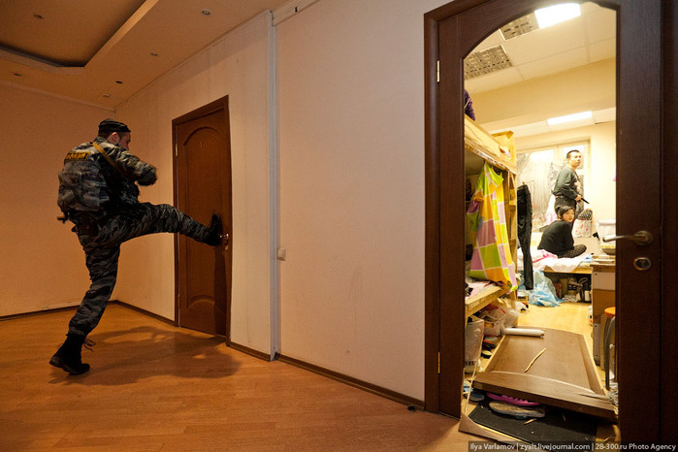
To smash down
вибити
The police smashed the door down to get into the house.

Slide 17

To sort out
вирішувати
Has the film sorted out its tax problems yet?

Slide 18
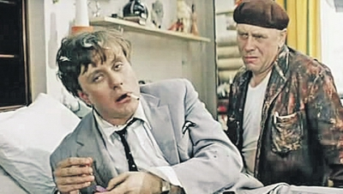
To sober up
протверезіти
Jack sobered up a bit when we left the pub and walked home.

Slide 19
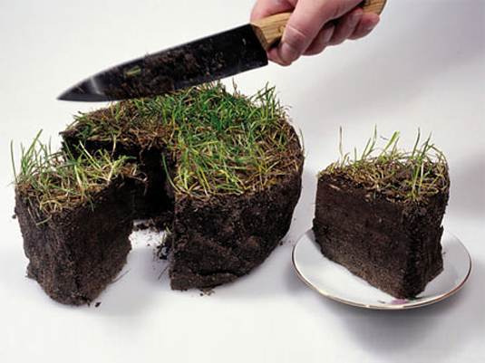

To split up
розділити
The teacher split the class up into groups of four.
розходитися
My parents split up when I was seven.

Slide 20
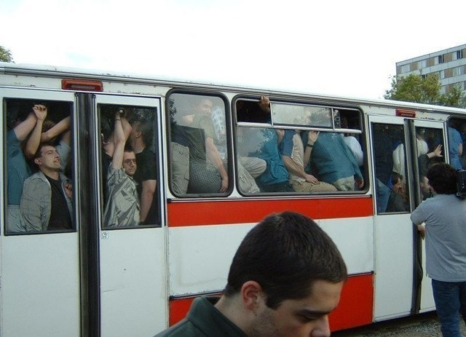
To squeeze up
втиснутися
Four of us had to squeeze up in the back of the car.

