Slide 1

How do we call people??

Slide 2
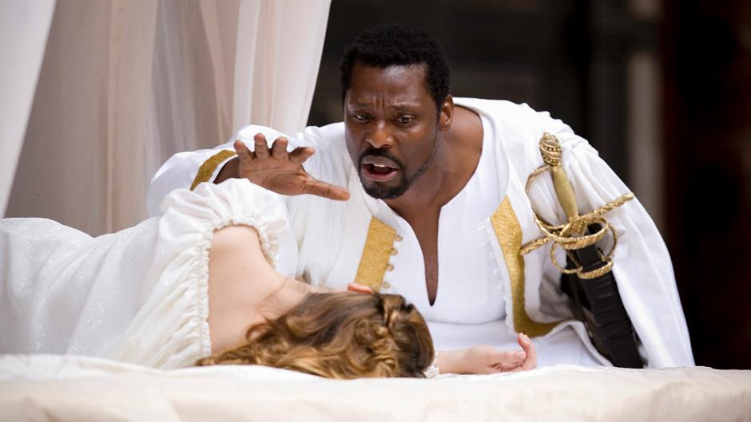
Othello
a very jealous husband

Slide 3
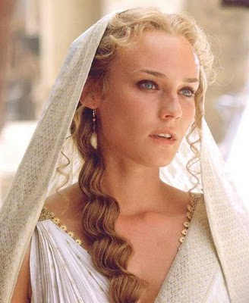
Helen of Troy
a very beautiful woman
in ancient Greek stories, the wife of Menelaus, the king of Sparta. Helen was famous for her great beauty. When Helen's lover Paristook her away to Troy with him, he caused the Trojan War. The phrase "the face that launched a thousand ships" is often used about her, since the Greeks sailed to Troy to bring her back.

Slide 4
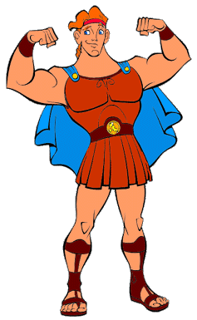
Hercules (Herakles)
a man of outstanding strength or size

Slide 5
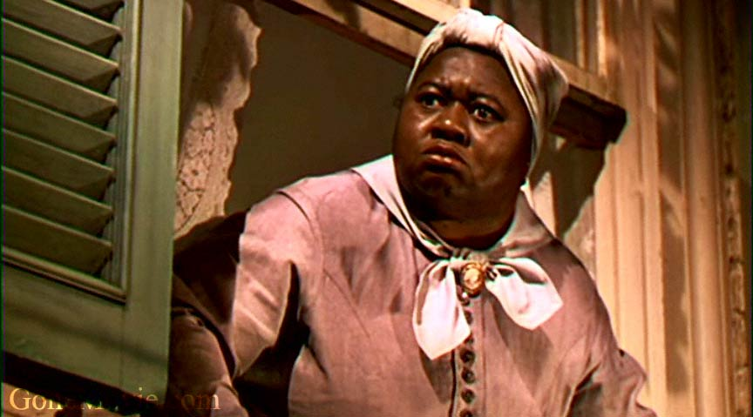
Mammy
a Black woman employed as a nurse or servant to a White family

Slide 6
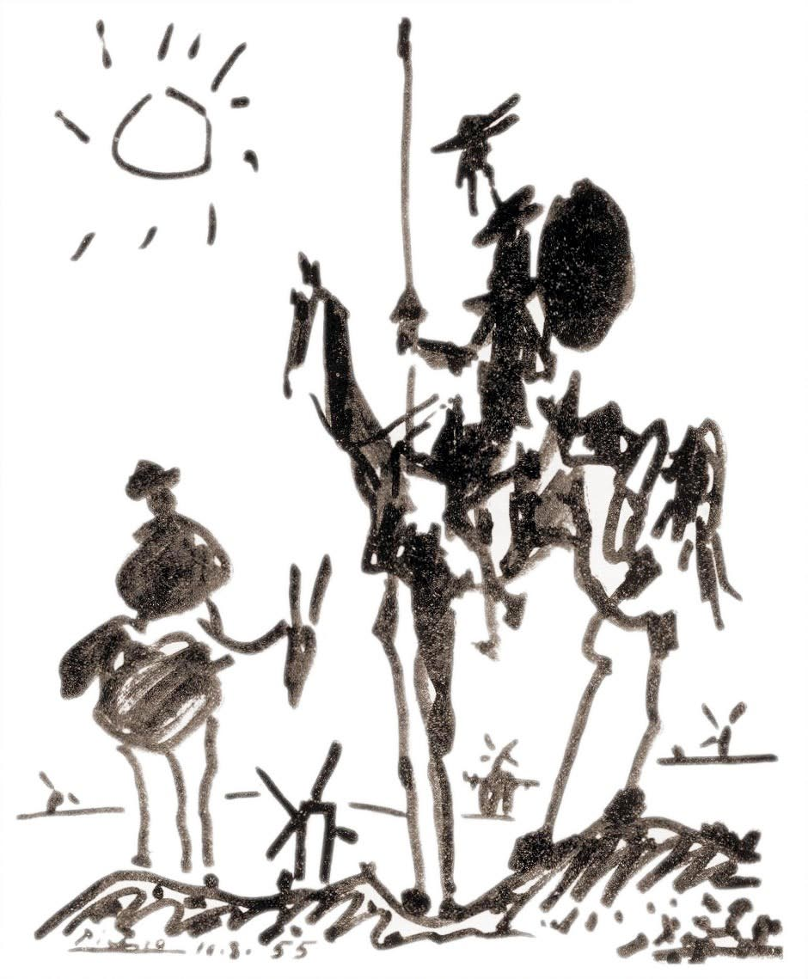
Don Quixote
- an impractical idealist
- someone who is determined to change what is wrong, but who does it in a way that is silly or not practical

Slide 7
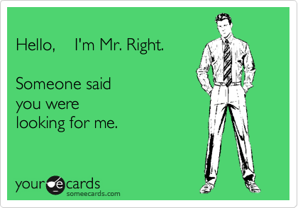
Mr Right
the man considered by a woman to be her perfect marriage partner

Slide 8
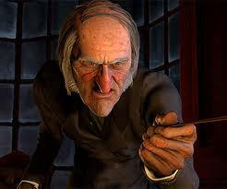
Scrooge
a mean or miserly person

Slide 9
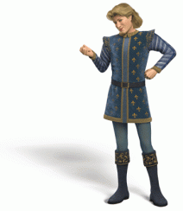
Prince Charming
a man who seems to her to be a perfect lover or boyfriend, because he is good-looking, kind, and considerate

Slide 10
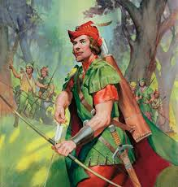
Robin Hood
Smb who will give everything he has to the poor

Slide 11
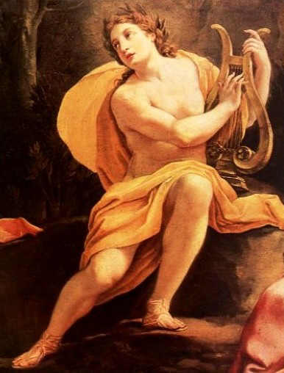
Apollo
a strikingly handsome youth

Slide 12
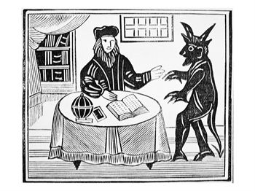
Faustus
a magician and alchemist who sells his soul to the devil in exchange for knowledge and power

Slide 13
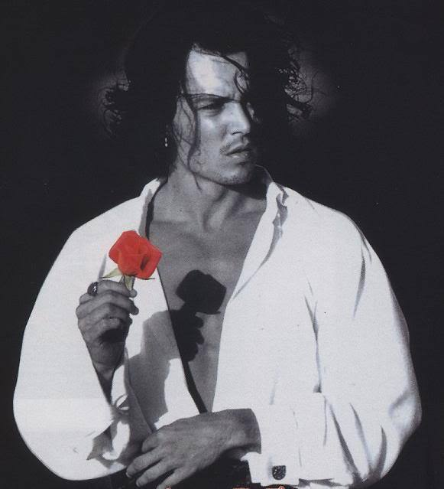
Don Juan
a successful seducer of women

Slide 14
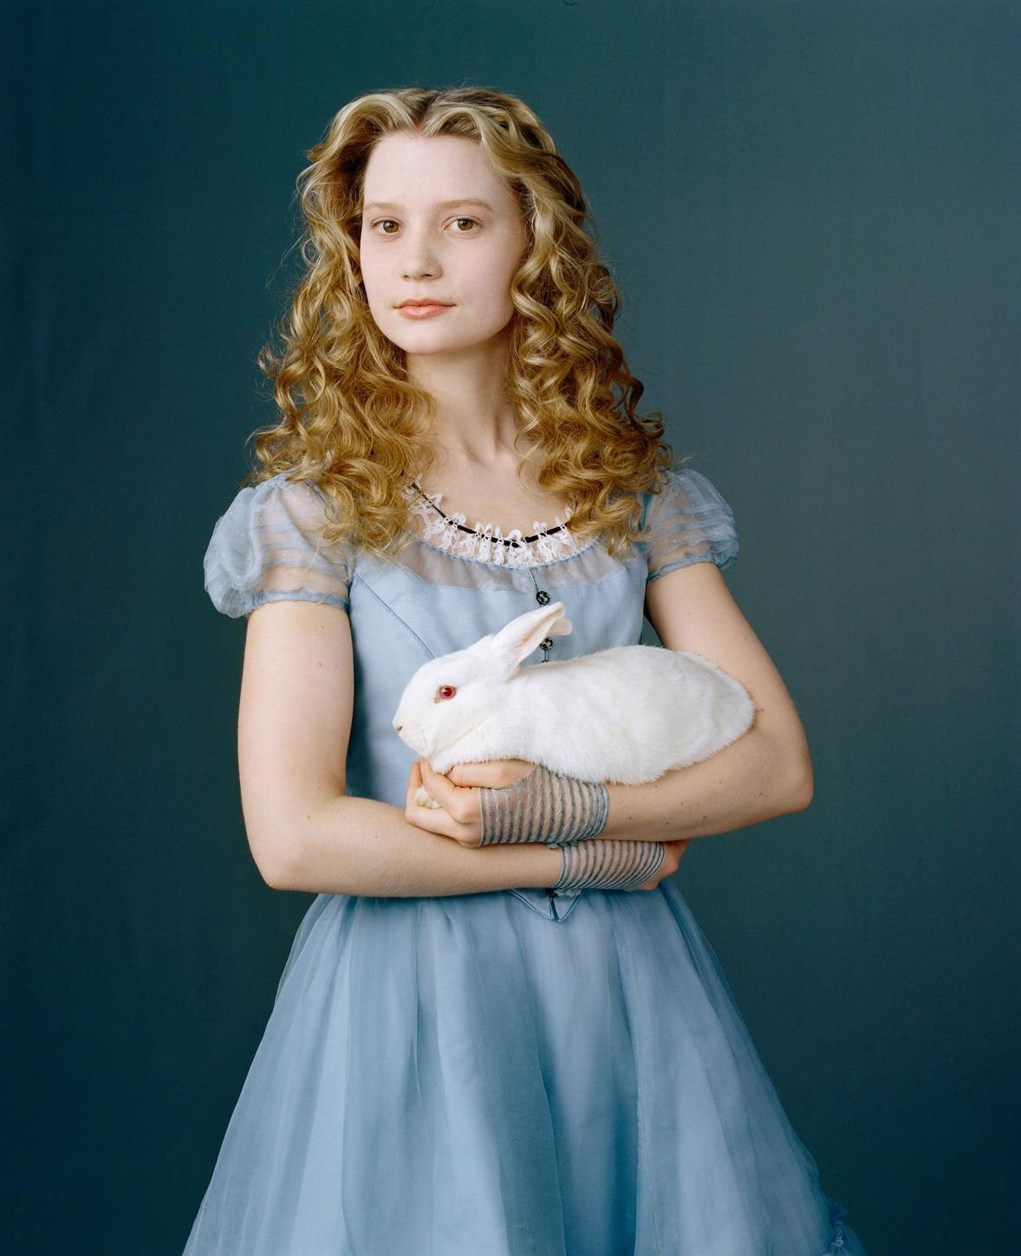
Alice in Wonderland
fantastic; irrational

Slide 15
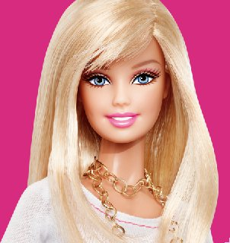
Barbie
a superficially attractive but insipid (lacking spirit; boring) young woman

Slide 16
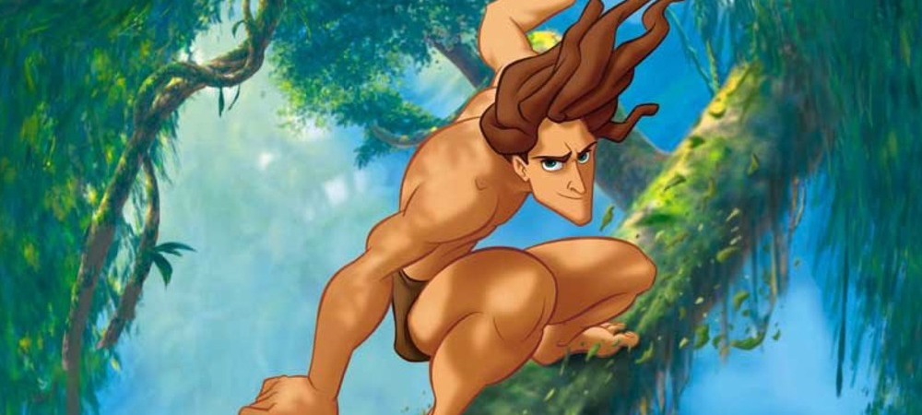
Tarzan
a man with great physical strength, agility, and virility

Slide 17
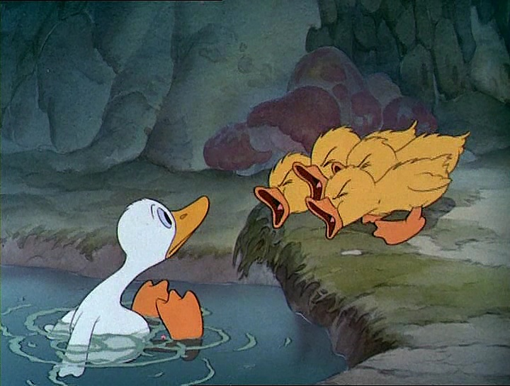
The Ugly Duckling
a person or thing, initially ugly or unpromising, that changes into something beautiful or admirable

Slide 18
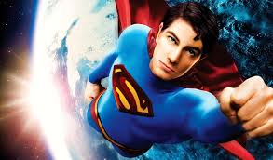
Superman
any man of apparently superhuman powers

Slide 19
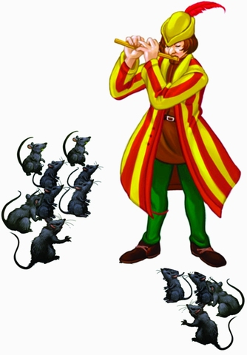
Pied Piper
a person who entices others to follow him

Slide 20
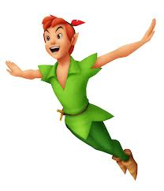
Peter Pan
a youthful, boyish, or immature man

Slide 21
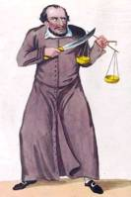
Shylock
a heartless or demanding creditor
the name of the heartless usurer in Shakespeare's The Merchant of Venice (1596)

Slide 22
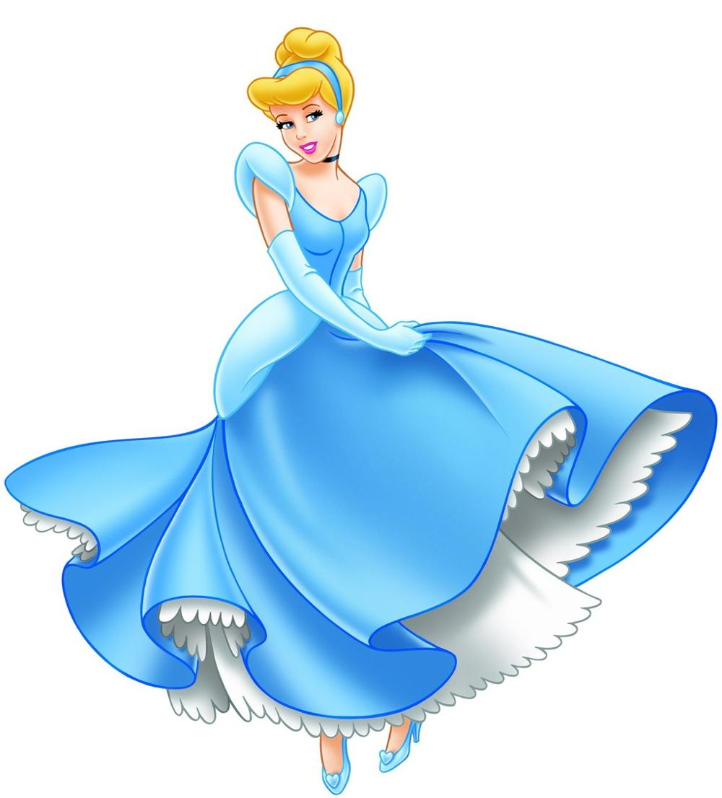
Cinderella
a girl who achieves fame after being obscure

Slide 23
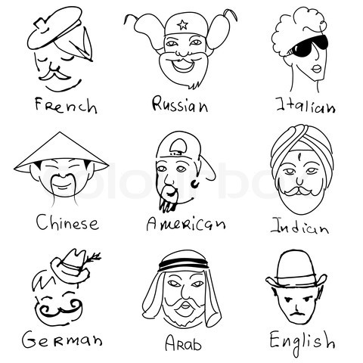

Slide 24
